Slide 1
MIND CONTROLLED ROBOTIC ARM
Nazim A Belabacci, Yibo Li, Prism Prajapati, Bibi Hajira M

Slide 2
Introduction and problem statement
Neurological diseases such as Parkinson or multiple sclerosis may result in losing control of upper limbs making it hard to perform simple tasks like grabbing or dropping an object.
We worked to reproduce a real gesture on a robot just by imagining/focusing on a specific task we want to achieve.

Slide 3
Related work
Noninvasive Electroencephalogram Based Control of a Robotic Arm for Reach and Grasp Tasks – Jianjun Meng et.al.
Control robotic arm to complete reach and grasp tasks efficiently using non-invasive BCI (Brain-computer interface)
13 human subjects modulated brain activity to control robotic arm
Classification of EEG Signals Based on Pattern Recognition Approach - Hafeez Ulla Amin et.al.
Proposed Pattern recognition approach to discriminate EEG signals recorded for different cognitive conditions
Wavelet coefficients extracted -> standardized -> optimized -> classification
Dataset I – Complex cognitive task(class 1) and baseline eyes open task(class 2)
Dataset II – Mental multiplication (class 1) and mental letter composing (class 2)
Classifiers such as KNN, SVM, MLP and NB were employed

Slide 4
Related work (cont.)
Brain-actuated robotic arm system using non-invasive hybrid brain-computer interface and shared control strategy – Lynfeng cao et al.
Proposed shared control model to automatically optimize the control commands
Employed hybrid BCI to better allocate commands with multiple functions
Notes:
Shared control strategies - the device does not only execute the decoded commands, but it is also involved in executing the task.

Slide 5
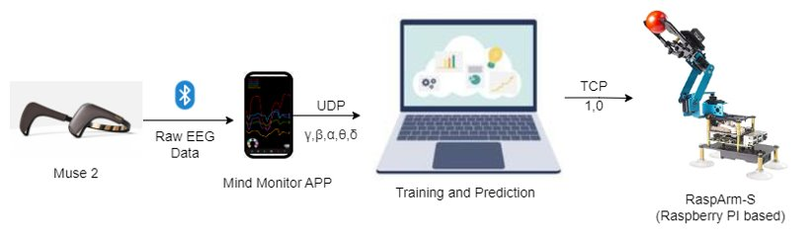
Project Overview (diagram, flow-chart)

Slide 6
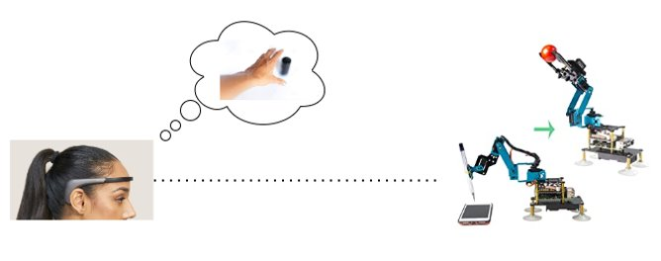
Proposed solution
We want to use Muse 2 to decipher brain signals from the frontal lobe related to specific tasks(grabbing/dropping an object) and reproduce the aimed task using a robotic arm. ​
​

Slide 7
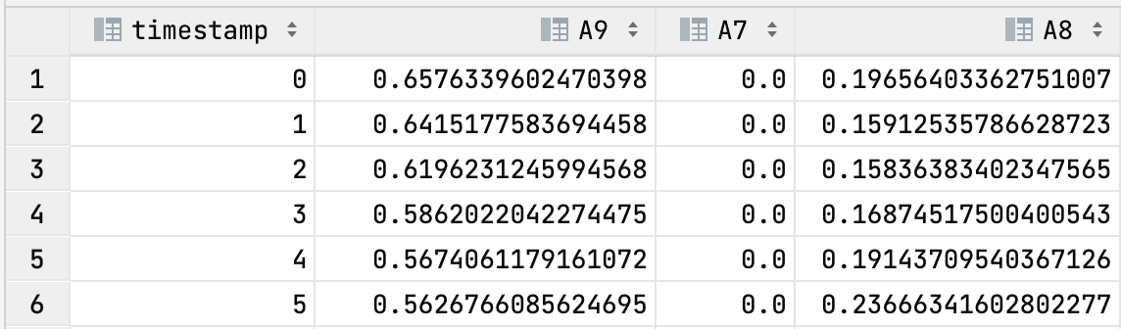
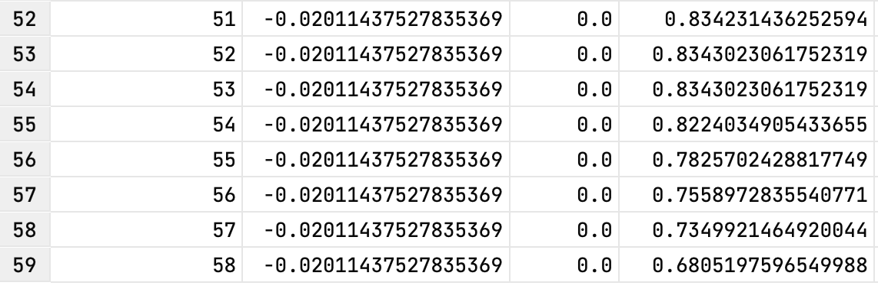
Data Collection, Classifier Training and Deploy (a)
Collect EEG signal from brain
Train classifier model
Deploy model in program
Monitor EEG signal and output class
Use class output to control robot arm
1. user defines two brain activities, e.g., eye blink and jaw teeth.
2. complete one cycle data collection (alpha, beta, delta, theta,
and gamma, each has four channels):
a. collecting EEG signals of one activity in 2 to 6 sec
(signal delay).
b. next 3-4 sec main thread sleep (signal recovers).
c. then collecting the EEG signals of the other activity in next
2 to 6 sec.
3. redo step 2 in next cycle until sample number is enough.
4. it is better if two activities have a clear separation in the
frequency bands by observation.

Slide 8
Data Collection, Classifier Training and Deploy (b)
Collect EEG signal from brain
Train classifier model
Deploy model in program
Monitor EEG signal and output class
Use class output to control robot arm
1. we used the Edge Impulse platform to build a classifier model (TensorFlow).
2. set different parameters combination (lr is 0.0005, epoch is 30, 80/20 for t/v, same NN architecture):
a. brain activities (hands, eye/teeth, feet, the class number was no more than 2):
some activities may have a better separation on frequency bands than others.
b. number of samples (30, 50, 100):
more samples usually show a clear partition trend to avoid underfitting.
c. frequency bands (group 1: alpha, beta, and delta, group 2: theta, and gamma, and group 3: all):
we observed that some frequency bands varied significantly when movements happen.
d. time duration in the measurement cycles (2 sec, 4 sec, 6 sec):
due to the signal delays and recovers, a proper time range is good to fit the moment of
maximum data variation.
3. chosen one of the classifier model with highest validation accuracy.

Slide 9
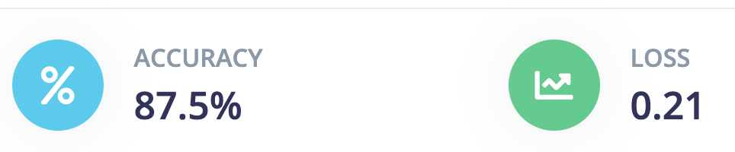
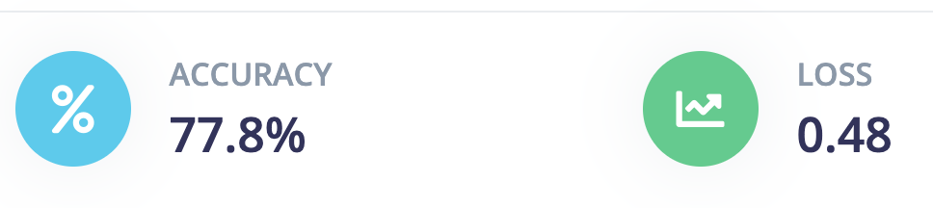
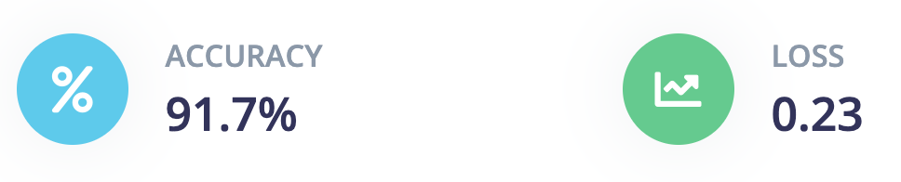
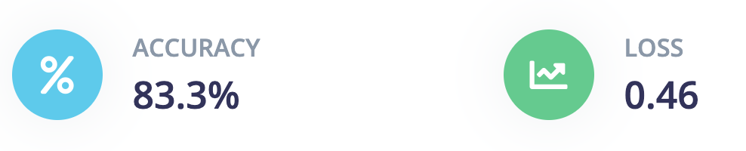
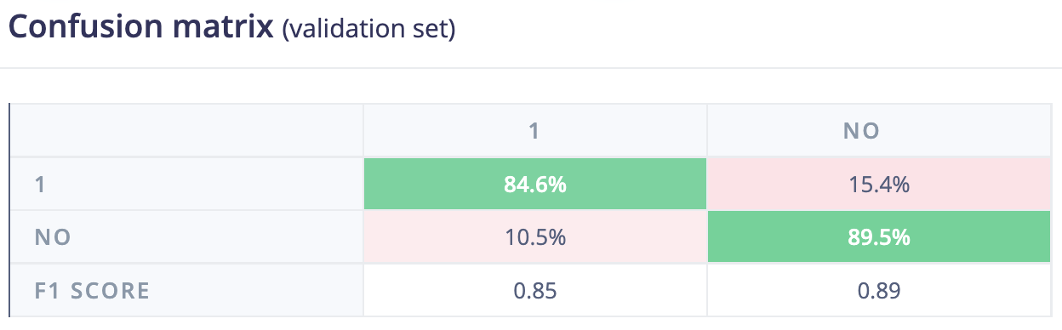
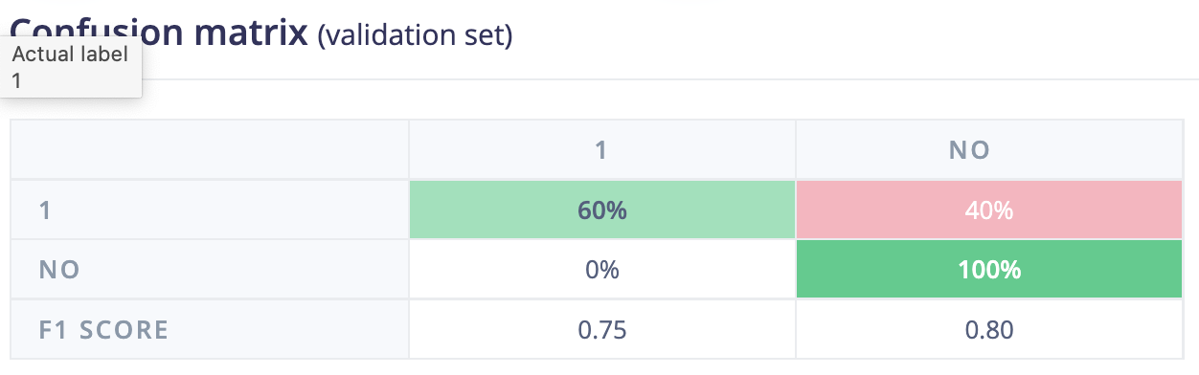
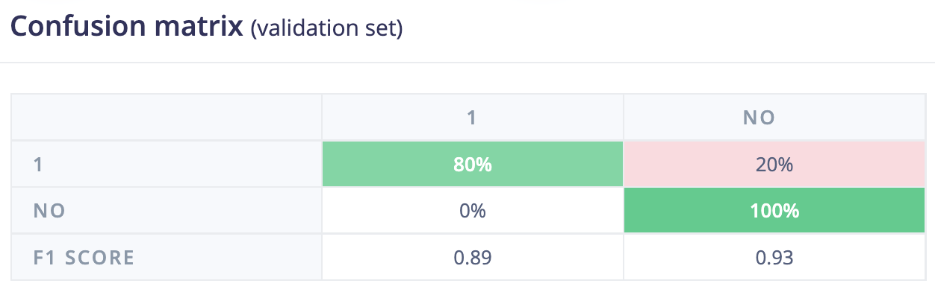
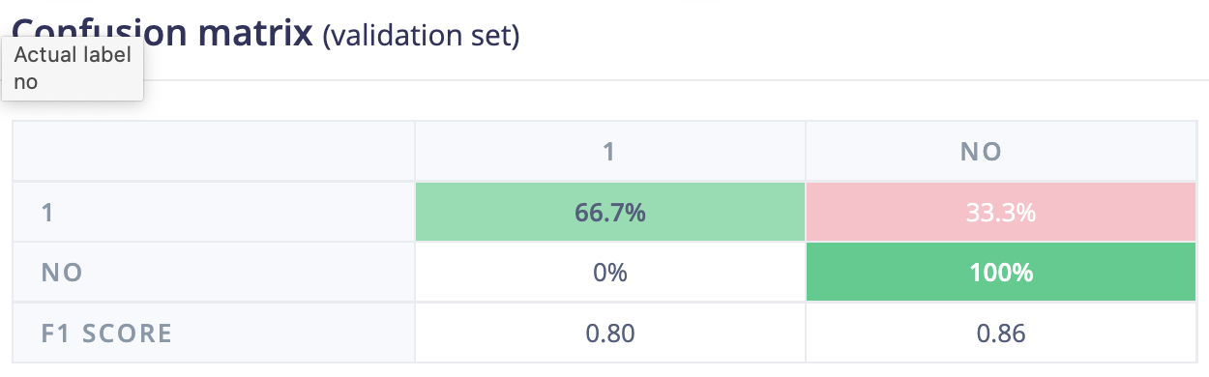
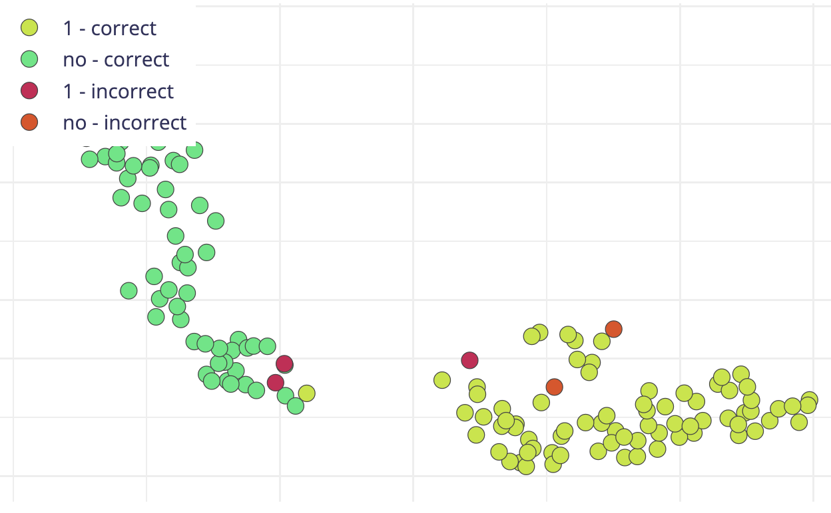
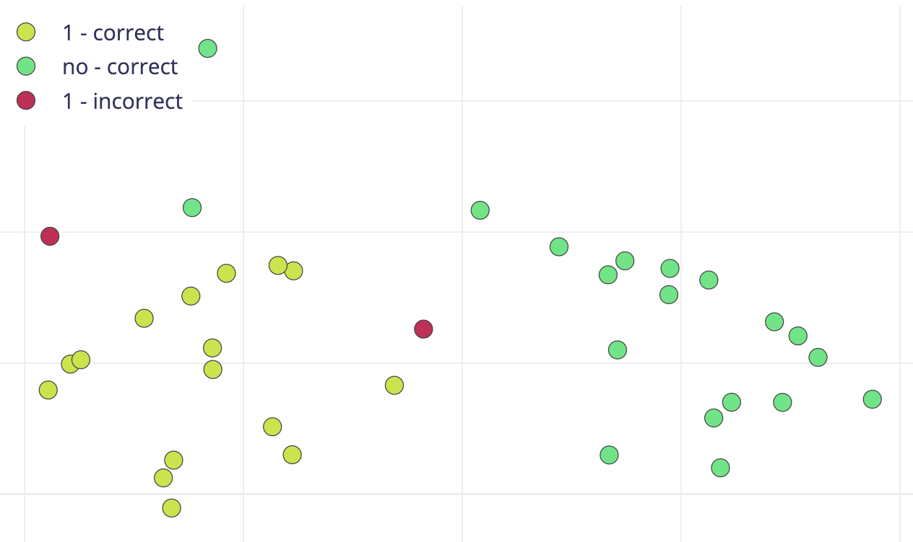
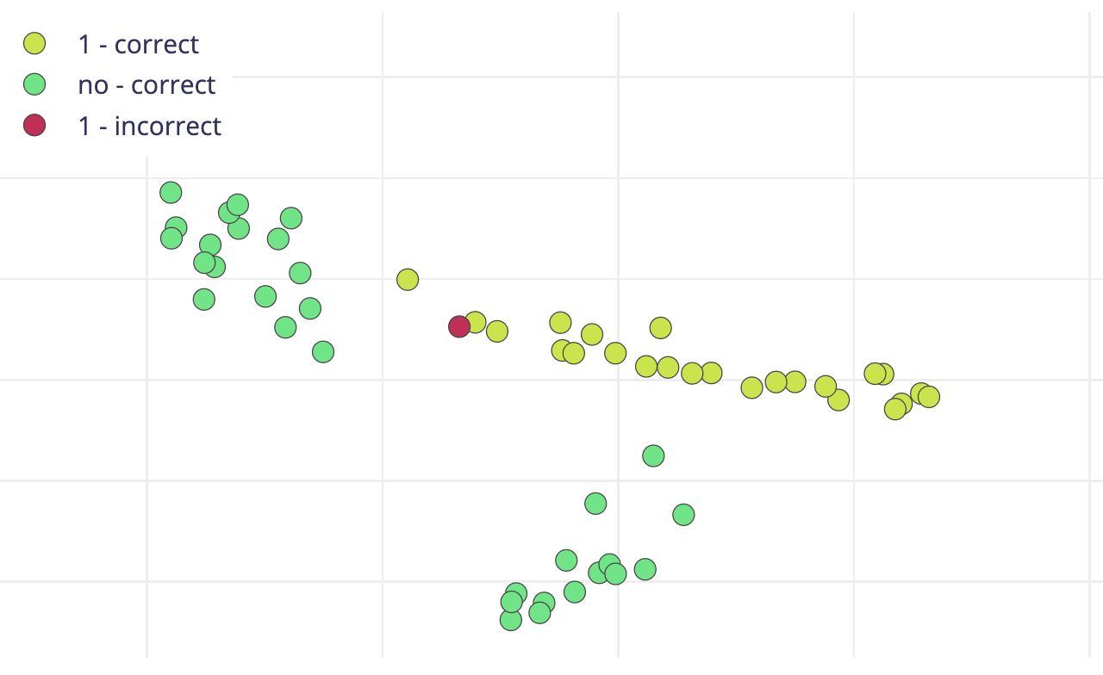
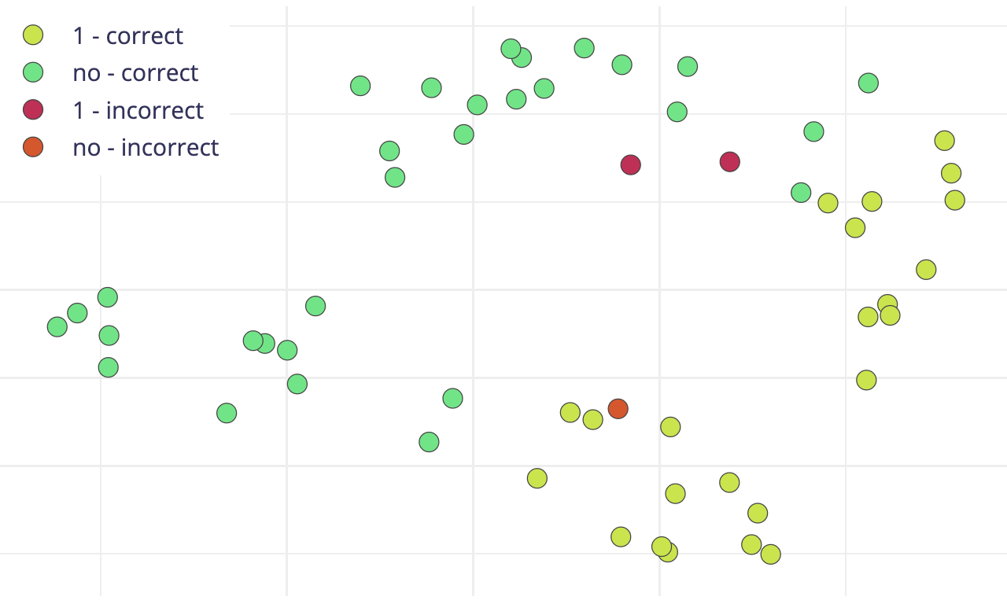
Data Collection, Classifier Training and Deploy (c)
Collect EEG signal from brain
Train classifier model
Deploy model in program
Monitor EEG signal and output class
Use class output to control robot arm
1. 100p/2s/2sec/all
2. 30p/2s/6sec/all
3. 30p/2s/4sec/all
4. 60p/2s/6sec/𝛼𝛽

Slide 10
Data Collection, Classifier Training and Deploy (d)
Collect EEG signal from brain
Train classifier model
Deploy model in program
Monitor EEG signal and output class
Use class output to control robot arm
1. after training and deploying the classifier model, we used the same setting to get new EEG signals.
2. and we used the classifier model to predict the brain activity class.
3. we did observe mistake in the classification process; we believe the model is sensitive to brain signal
change, for some cases, sometimes it is hard to say the output is from the real brain activity or it is from the
environment noise, some models could be overfitting (frequency feature's variance is small).
4. in our experiments, at this point, eye blink and jaw teeth classification is much reliable than others.
5. so, we used the eye blink and jaw teeth to control the robot arm in the demo.
6. My teammate Prism will talk about the demo part.

Slide 11
Demo
Demo video in (OneDrive)

Slide 12
Conclusion
We assembled robotic arm, implement Raspberry Pi in Robotic Arm, used the Muse 2 to detect brain signals, used M.L. for data collection and implementation​.
We were able to train a model to classify two actions​.
Even though we were able to deploy the whole system together, the real-time prediction was not reliable, depending on the specific brain actions combined, and some time the prediction fails.​
We presented a proof of concept for a mind-controlled robot​ using Jaw clenching and blinking.

Slide 13
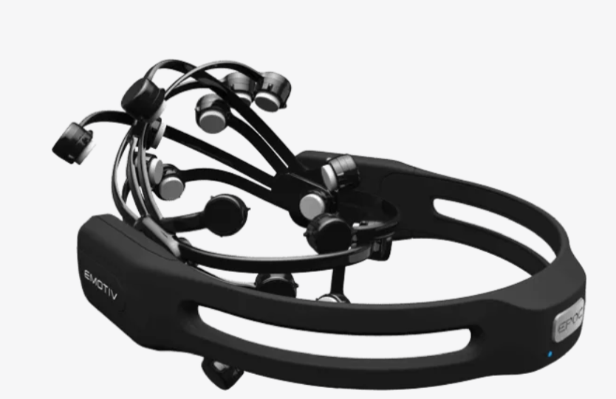
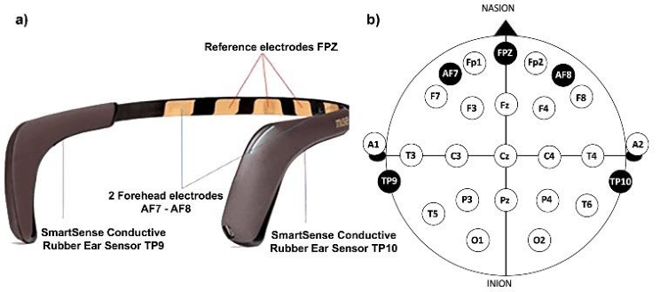
Future work
Improve
Improve training with publicly available dataset (transfer learning)
Optimize
Use
Use a 16-channel headset
Outlier detection and removal
PCA and ICA
Temporal and frequency-based features to augment number of features
Metric learning and mahalanobis distance

Slide 14
References
Noninvasive Electroencephalogram Based Control of a Robotic Arm for Reach and Grasp Tasks – Jianjun Meng et al.
Classification of EEG Signals Based on Pattern Recognition Approach - Hafeez Ulla Amin et al.
Outlier detection for single-trial EEG signal analysis - Boyu Wang et.al.
Brain controlled robots : principles behind mind control of robots - https://www.futurelearn.com/info/courses/robotic-future/0/steps/26359
Application of wearable EEG sensors for indoor thermal comfort measurements - Silvia Angela Mansi et al.

Slide 15
Questions / Feedback

